Slide 1
Integrated Literacy Assignment
By: Nichole Matzke
SST 309-01

Slide 2
GCLE:
4-C1.0.3 Describe the purposes of government as identified in the Preamble of the Constitution

Slide 3
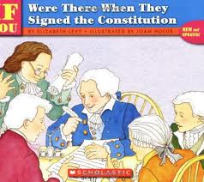
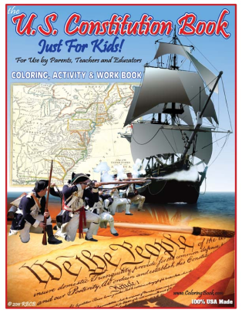
Trade books
http://childrenslit-socialstudies.wikispaces.com/We+the+Kids+Reinforcing+Activity
Title: If You Were There When They Signed the Constitution
By: Elizabeth Levy
About the book: In a lively question and answer format, readers are taken behind the locked doors of the Philadelphia State House during the dramatic Constitutional Convention

Slide 4
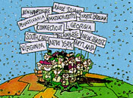
Song
http://www.youtube.com/watch?v=30OyU4O80i4&feature=player_embedded

Slide 5
Videos
http://www.youtube.com/watch?feature=player_embedded&v=GlgTwp93E48
http://www.youtube.com/watch?v=Mi7FNDh4ARg.

Slide 6
Websites
http://literacylinks.civiced.org/search_results.php?new_keyword=preamble&keyword=&material=activity&text=&learning_objective=&time_to_complete=&aq=
http://www.squidoo.com/constitutionlapbookunit#module37736292
http://www.rightsofthepeople.com/education/government_for_kids/9-12/games/preamble_scramble.php
http://www.icivics.org/web-quests/constitution-rules-running-country?cck_pager_group_pages=2
http://teacher.scholastic.com/scholasticnews/indepth/constitution_day/constitution.asp

Slide 7
Foldable
http://www.flickr.com/photos/37445435@N07/5248563517/.

Slide 8
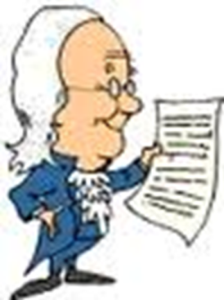
Resources
http://libraryschool.campusguides.com/content.php?pid=205947&sid=1801130
http://www.politicalcartoons.com/cartoon/34fa1db5-8d35-46ca-8004-4eabb44dd28e.html
http://www.scholastic.com/browse/collection.jsp?id=391
http://childrenslit-socialstudies.wikispaces.com/We+the+Kids+Reinforcing+Activity
http://www.youtube.com/watch?v=30OyU4O80i4&feature=player_embedded
http://www.youtube.com/watch?feature=player_embedded&v=GlgTwp93E48
http://www.youtube.com/watch?v=Mi7FNDh4ARg.
http://literacylinks.civiced.org/search_results.php?new_keyword=preamble&keyword=&material=activity&text=&learning_objective=&time_to_complete=&aq=
http://www.rightsofthepeople.com/education/government_for_kids/9-12/games/preamble_scramble.php
http://teacher.scholastic.com/scholasticnews/indepth/constitution_day/constitution.asp
http://www.squidoo.com/constitutionlapbookunit#module37736292
http://www.icivics.org/web-quests/constitution-rules-running-country?cck_pager_group_pages=2
http://www.flickr.com/photos/37445435@N07/5248563517/.

